Slide 1
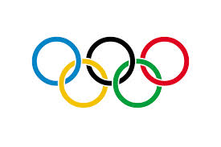
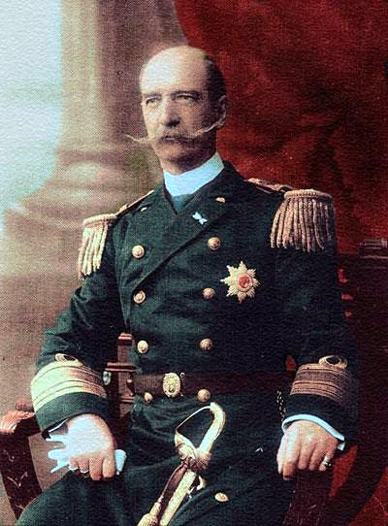
1896 Summer Olympics
Jack Berner
Period 3

Slide 2
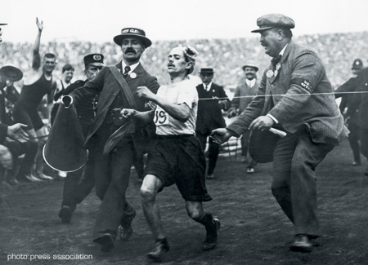
Before the Games
Multiple sport festivals existed across Europe such as the Wenlock games, and other ‘Olympic’ games, however none of them were international.
Sports in Europe were becoming increasingly popular and well funded
Wenlock Olympic Games

Slide 3
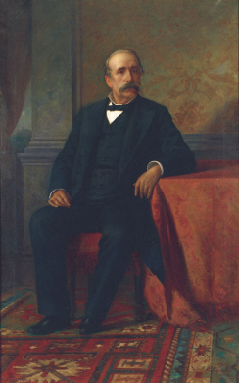
Origins of the Olympics
The original idea for an international sporting event was created by Dr William Brookes (who unfortunately died the year before the first Olympic games), and this in turn influenced Pierre de Coubertin
Pierre de Coubertin was the true founder of the Olympics and the International Olympic Committee (IOC)
On 18 June 1894 in Sorbonne, Coubertin organized a conference in which he suggested the Olympic games, and it was very well received
Earlier Greek games were sponsored by business tycoons George Averoff and the Zappa family, and this inspired Coubertin to receive the same monetary support from the same people.
George Averoff
“With deep feeling towards Baron de Coubertin's courteous petition, I send him and the members of the Congress, with my sincere thanks, my best wishes for the revival of the Olympic Games.”
-King George I of Greece

Slide 4
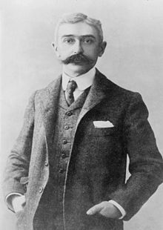
Coubertin’s Request
Coubertin requested that the Olympic games be held at Athens to the Greek Royal Family, and the request was well received; King George I said the following,
“With deep feeling towards Baron de Coubertin's courteous petition, I send him and the members of the Congress, with my sincere thanks, my best wishes for the revival of the Olympic Games”
A Greek judge named Stefanos Dragoumis tried to repeal the motion, believing Greece could not host the games, but he was not able to.
Pierre de Coubertin

Slide 5
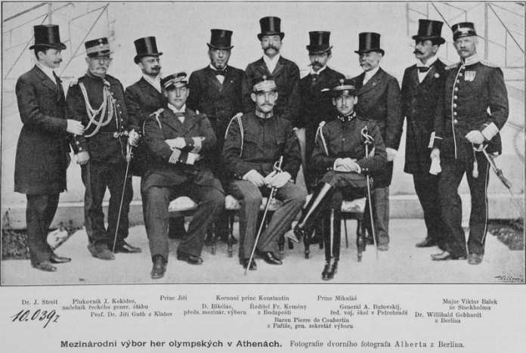
Game Planning/Organization
The International Olympic Committee estimated that hosting the games would cost about 3,740,000 drachmas
Much of the required funds came from enthusiastic Greek citizens, and the king’s royal purse, however the majority of funds from one person came from George Averoff
The IOC held a number of administrative votes, and chose to only allow amateur athletes to participate
International Olympic Committee
(Prince Constantin in the center)

Slide 6
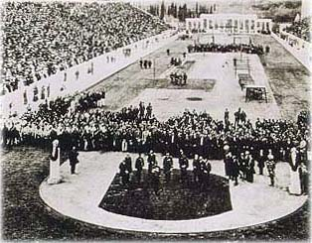
Opening Ceremonies
The opening ceremony took place on April 6th
80,000 spectators were present
The Greek National anthem was played and nine orchestras played various songs afterward
Prince Constantin gave the first speech
There was no Olympic flame (which was introduced in 1928)
The crowd cheered, “Long live the Crownprince! Long live Mr. Averoff ! God bless our nation!”
Opening Ceremony

Slide 7
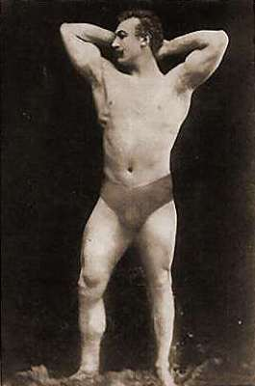
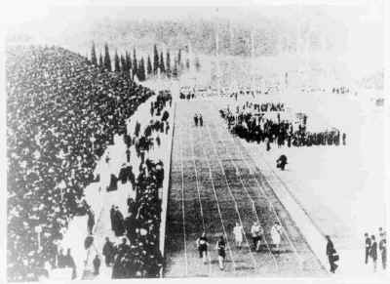
Sports and Events
The nine sports played during the Olympics were athletics, gymnastics, weightlifting wrestling, swimming, tennis, shooting, cycling, and fencing.
Football, cricket, rowing, and boating were originally intended to be included, but did not receive funding
Greek participants outnumbered all the other nations combined
Final 100 meters of the race Launceton Elliot, popular among the Greek ladies

Slide 8
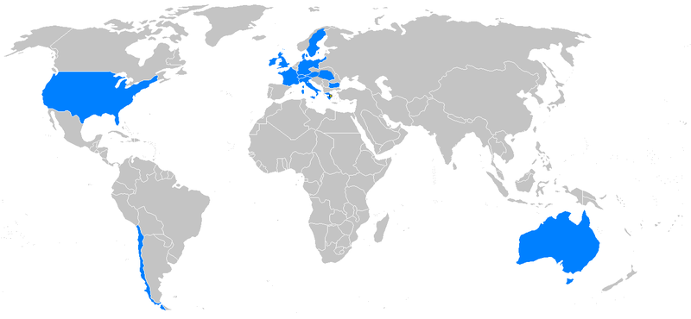
Countries
The attending countries in no particular order were, Greece, USA, Italy, Britain, France, Austria-Hungary (Although the two nations were considered separate in medal count), Switzerland, Chile, Sweden, Germany, Bulgaria, Australia (although it was still technically part of Britain).
Countries like Belgium and Russia were invited, but did not attend
Map of
participating
nations

Slide 9
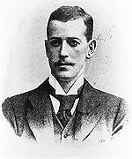
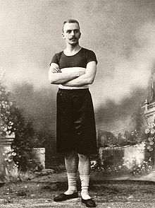
Countries (Cont.)
Tennis doubles teams were allowed to have different nations, there were three of these, and one of them won a gold medal (John Boland [GBR] and Friedrich Traun [GER]
No Asian, African, or Pacific Island nations were invited to the event
This was the first event in which Great Britain participated as an entire nation, rather than its constituent kingdoms
John Boland and his partner Friedrich Traun

Slide 10
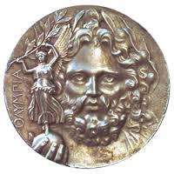
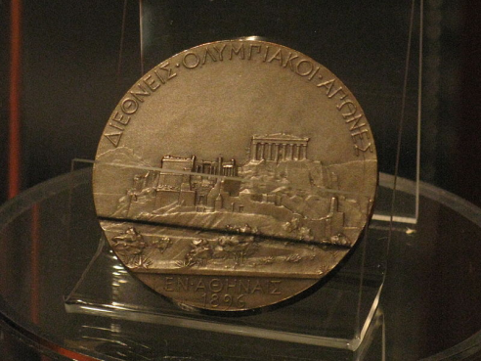
Medals/Winners
By modern IOC medal values, the Greece won, and the US came in second place
Greece won the largest amount of medals (largely because it had a great amount of competitors)
The medal system was initially different, with the winners receiving silver medals, and the second place getting a copper medal
The IOC has given a modern medal count to each nation (next page)
First Place Silver Medal Runner Up Medal

Slide 11
Nation | Gold | Silver | Bronze | Total
United States | 11 | 7 | 2 | 20
Greece | 10 | 17 | 19 | 46
Germany | 6 | 5 | 2 | 13
France | 5 | 4 | 2 | 11
Great Britain | 2 | 3 | 2 | 7
Hungary | 2 | 1 | 3 | 6
Austria | 2 | 1 | 2 | 5
Australia | 2 | 0 | 0 | 2
Denmark | 1 | 2 | 3 | 6
Switzerland | 1 | 2 | 0 | 3
Sweden | 0 | 0 | 0 | 0
Bulgaria | 0 | 0 | 0 | 0
Chile | 0 | 0 | 0 | 0
Italy | 0 | 0 | 0 | 0

Slide 12
Works Cited
"1896 Summer Olympics." Princeton University. N.p., n.d. Web.
"Athens 1896 6th April - 15th April." Athens 1896 Summer Olympics. N.p., n.d. Web.
"The Century; a Popular Quarterly Volume 0053 Issue 1 (Nov 1896)." The Century; a Popular Quarterly Volume 0053 Issue 1 (Nov 1896). N.p., n.d. Web.
"Event Results." Olympic Games Medals, Results, Sports, Athletes|Médailles, Résultats, Sports Et Athlètes Des Jeux Olympiques. N.p., n.d. Web.
"Historical People." - Pierre De Coubertin. N.p., n.d. Web.

Slide 13
Works Cited
"Latest History Articles:." Britain Magazine. N.p., n.d. Web.
Mallon, Bill, ed. The 1896 Olympic Games. Jefferson: McFarland &,, 1998. Print.
"Olympic Games 1896 Athens." Participating Countries Olympic Games 1896. N.p., n.d. Web.
"World Stadiums - Stadiums in Greece." World Stadiums - Stadiums in Greece. N.p., n.d. Web.

Slide 14
Images
All images not cited in the work cited used wikimedia commons files

